Slide 1
Module 2
Introduction to Cryptography

Slide 2
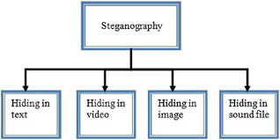
steganography
Steganography is the technique of hiding secret data within an ordinary, non-secret, file or message in order to avoid detection; the secret data is then extracted at its destination.

Slide 3
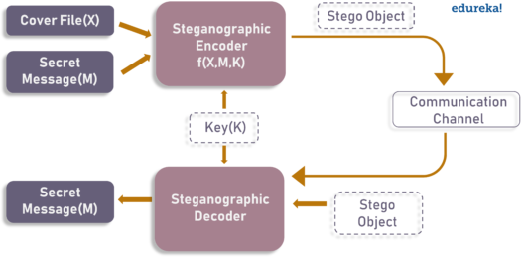

Slide 4
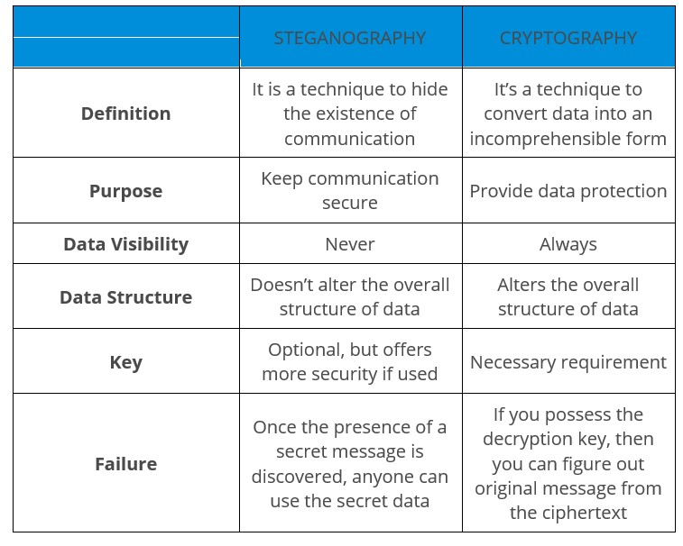

Slide 5
Text Steganography
Text Steganography is hiding information inside the text files. It involves things like changing the format of existing text, changing words within a text, generating random character sequences or using context-free grammars to generate readable texts. Various techniques used to hide the data in the text are:
Format Based Method
Random and Statistical Generation
Linguistic Method

Slide 6
Best Tools to Perform Steganography
Stegosuite is a free steganography tool which is written in Java. With Stegosuite you can easily hide confidential information in image files.
Steghide is an open source Steganography software that lets you hide a secret file in image or audio file.
Xiao Steganography is a free software that can be used to hide data in BMP images or in WAV files.
SSuite Picsel is another free portable application to hide text inside an image file but it takes a different approach when compared to other tools.
OpenPuff is a professional steganographic tool where you can store files in image, audio, video or flash files
Video on steganography

Slide 7
Image Steganography
Hiding the data by taking the cover object as the image is known as image steganography. In digital steganography, images are widely used cover source because there are a huge number of bits present in the digital representation of an image. There are a lot of ways to hide information inside an image. Common approaches include:
Least Significant Bit Insertion
Masking and Filtering
Redundant Pattern Encoding
Encrypt and Scatter
Coding and Cosine Transformation

Slide 8
Audio Steganography
In audio steganography, the secret message is embedded into an audio signal which alters the binary sequence of the corresponding audio file. Hiding secret messages in digital sound is a much more difficult process when compared to others, such as Image Steganography. Different methods of audio steganography include:
Least Significant Bit Encoding
Parity Encoding
Phase Coding
Spread Spectrum
This method hides the data in WAV, AU, and even MP3 sound files.

Slide 9
Video Steganography
In Video Steganography you can hide kind of data into digital video format. The advantage of this type is a large amount of data can be hidden inside and the fact that it is a moving stream of images and sounds. You can think of this as the combination of Image Steganography and Audio Steganography. Two main classes of Video Steganography include:
Embedding data in uncompressed raw video and compressing it later
Embedding data directly into the compressed data stream

Slide 10
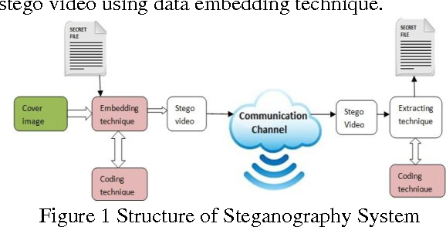

Slide 11
Biometric Authentication
Biometric authentication refers to the security procedure that involves the use of unique biological characteristics of individuals such as retinas, irises, voices, facial characteristics, and fingerprints in order to verify people are who they claim to be. This process is used to control access to physical and digital resources, such as buildings, rooms, and different devices.
The word biometric is a combination of two words: bio (human) and metric (measurement).
In simpler words, biometrics are any metrics related to human features which make an individual different from other individuals.

Slide 12
Biometric Authentication Methods
Types of Biometric Authentication Methods
Facial Recognition
Fingerprint Recognition
Eye Recognition
Voice Recognition

Slide 13
Facial Recognition
Facial recognition software analyzes the geometry of the face, including the distance between the eyes, distance between the chin and nose, etc., to create an encrypted digital model for your facial data.
When authenticating, the facial recognition tool will scan your face in real time and compare the model to the one stored within the system.

Slide 14
Fingerprint Recognition
Law enforcement officers have used fingerprints as a form of identification for years. A fingerprint reader operates on the same principles, but the entire process is digitized. Everyone’s fingerprints are unique to them.
So, by analyzing the ridges and pattern of the print, fingerprint scanners create a digital model which is compared against future attempts to authenticate.

Slide 15
Eye Recognition
In a retinal scan, the authenticator shines a light briefly into the eye to illuminate the unique pattern of blood vessels in the eye.
By mapping this pattern, the eye recognition tool can compare a user’s eyes against an original. Iris scans work similarly, but they analyze the colored rings found in the iris.

Slide 16
Voice Recognition
Voice recognition analyzes the sound of the user’s voice. Each person’s unique voice is determined by the length of their vocal tract and the shape of their nose, mouth, and larynx.
All these factors make analyzing the user’s voice a strong method of authentication.

